Slide 1
Modeling with NLP Using Text Data from Reddit
Matt Williams
July 24th, 2020

Slide 2
Problem Statement
A linguistics researcher is interested in studying how people communicate in online forums. They have decided to look to Reddit – “the front page of the internet” – as a source for their investigation. They’ve identified two subreddits for analysis: r/AskMen and r/AskWomen. However, they lack the skills necessary to parse through the data quickly. They’ve hired a consulting firm to help with the project, with a goal of determining whether the language used in posts from each subreddit is sufficient to predict which subreddit a post comes from.
Disclaimer: observations are posts from users of r/AskMen and r/AskWomen; we are not making assumptions or generalizations about genders.

Slide 3
Collecting the Data
Python Reddit API Wrapper (PRAW)
Nearly 1,900 Observations from r/AskWomen and r/AskMen
Feature | Data Type | Summary
title | Object | Text for title of post
score | Integer | # Upvotes - # Downvotes
url | Object | Url for specific post
number of comments | Integer | How many comments on a post received
created | Float | Timestamp for when item was posted
body | Object | Supporting text for post (60% of posts were null)
subreddit | Integer | 0 = r/AskMen; 1 = r/AskWomen
Image Source
Notes:
-Body: 60% null
-subreddit: 0 askmen, 1 askwomen

Slide 4

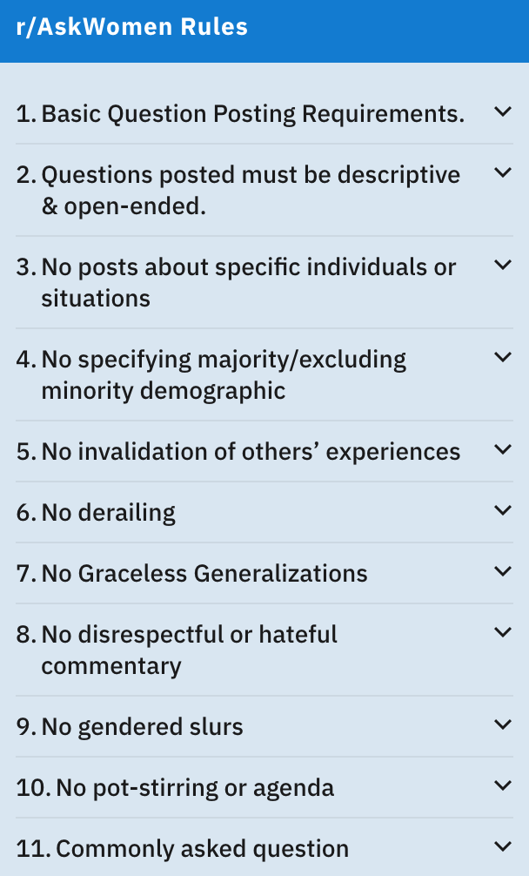
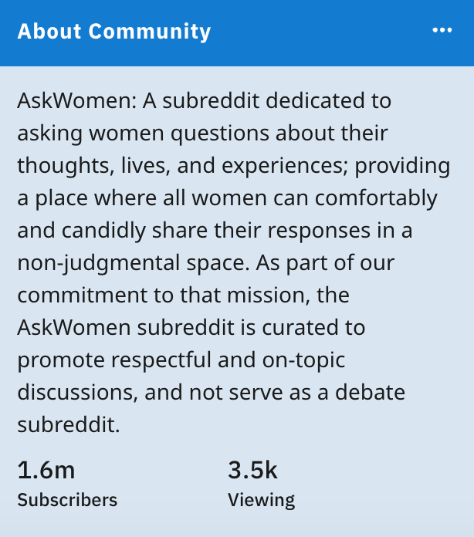
r/AskWomen
Source: https://www.reddit.com/r/AskWomen/
Created July 17th, 2010
Data based on 980 newest posts
Notes:
- happy belated 10th birthday
-read communit and title

Slide 5
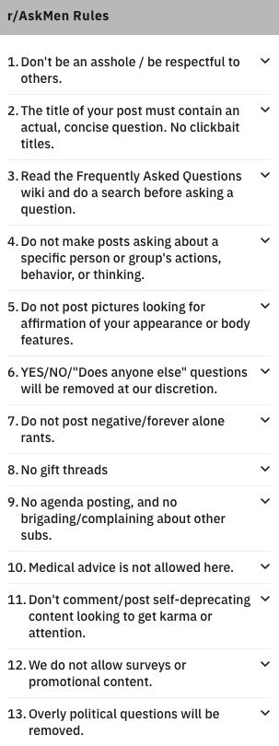

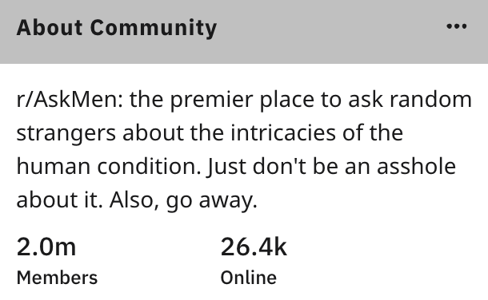
r/AskMen
Source: https://www.reddit.com/r/AskMen/
Created August 30th, 2010
Data based on 983 newest posts
Notes:
- upcoming 10th birthday

Slide 6
25 Most Commonly Used Words by Subreddit
r/AskMen
r/AskWomen
Notes:
- stopwords = 'english' removed
- relationship words: friend, friends, people, person, partner
- take a step further and see what subreddits have in common

Slide 7
Notes:
- common: relationship words: relationship, partner, friends, people
- advice words: feel, think, deal
-men only: speak of opposite gender, use sex instead of love
- women only: do not speak of opposite gender

Slide 8
25 Most Common Bigrams
Notes:
-red box indicates common bigrams
- 9 in common (40%)
- still a lot of language in common (specifically relationship/advice words)
- starting to look harder

Slide 9
25 Most Common Trigrams
Notes:
- fewer in common
- counts are pretty low; not a lot of repeat trigrams
- askwomen count decreases to 1 pretty quickly

Slide 10
Numeric Variables
Since these do not have a strong relationship with our target, we will only be using text data for modeling
Notes:
- using test from post titles only
- body: 60% nulls, so decided to exclude

Slide 11
Modeling
Model | Vectorizer | Accuracy
 |  | Best Score | Train | Test
Logistic Regression | TF-IDF | 0.6997 | 0.8987 | 0.6904
Extra Trees | TF-IDF | 0.6877 | 0.9905 | 0.6925
Multinomial Naïve Bayes | Count | 0.6868 | 0.9171 | 0.6762
Logistic Regression | Count | 0.6834 | 0.9552 | 0.7088
Random Forest | Count | 0.6800 | 0.9905 | 0.6965
Random Forest | TF-IDF | 0.6793 | 0.9905 | 0.6823
Multinomial Naïve Bayes | TF-IDF | 0.6712 | 0.9300 | 0.6639
Extra Trees | Count | 0.6692 | 0.9905 | 0.7006
Measure: Accuracy
Baseline Accuracy: .5
Default hyperparameters
Extreme overfitting
TF-IDF vectorizer performs better
Decision criteria: further explore models with the highest cross val scores
Notes:
-sample of models used
- model, then vectorizer
- tf-idf performs slightly better, greater weight on words that appear in fewer documents, and seem to have a lot of common words

Slide 12
Logistic Regression
Model | Vectorizer | Accuracy
 |  | Best Score | Train | Test
Logistic Regression | TF-IDF | 0.695 | 0.8397 | 0.7026
 |  | Hyperparameters
 |  | TF-IDF | Max Feature | 1000
 |  | TF-IDF | Max DF | 0.9
 |  | TF-IDF | Min Df | 2
 |  | TF-IDF | N-gram Range | (1,1)
 |  | TF-IDF | Stop Words | None
Notes:
- 6 ercent off training
- 1 percent increase on test score

Slide 13
Extremely Randomized Trees
Model | Vectorizer | Accuracy
 |  | Best Score | Train | Test
Extra Trees | TF-IDF | 0.6787 | 0.8016 | 0.6965
 |  | Hyperparameters
 |  | Extra Trees | Max Depth | 4
 |  | Extra Trees | Estimators | 125
 |  | TF-IDF | Max Features | 500
 |  | TF-IDF | N-gram Range | (1,1)
 |  | TF-IDF | Stop Words | None
Notes:
- 19% off training
- .4% increase
- arguably best model in terms of bias variance tradeoff- able to best reduce the variance significantly and marginally increase test score

Slide 14
Conclusion & Recommendations
r/AskMen or r/AskWomen? Don’t ask me!
Lots of common language and themes in these subreddits (more cleaning during pre-processing)
Models used are prone to overfitting with this data
Further fine tune hyperparameters
Experiment with other models
Using post titles is not enough - Incorporate more data (gather more observations; incorporate comments; use ‘body’ column)

Slide 15
Questions?

